Slide 1

7 Habits of
Successful Students
By Kennedy’s Korner

Slide 2
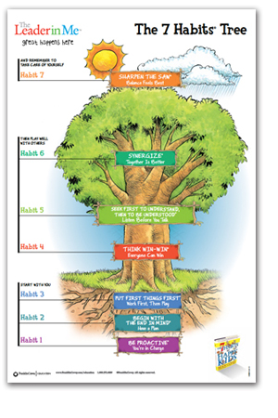

7 Habits
The 7 Habits of Happy Kids is a great book to read and share with your class.
Keep in mind – the 7 Habits will never be mastered.. It’s a way of thinking – a way of life..
As an educator – you need to LIVE these habits before you can truly teach them to your students. It’s not a program – it’s a shift in the way we think and act.

Slide 3


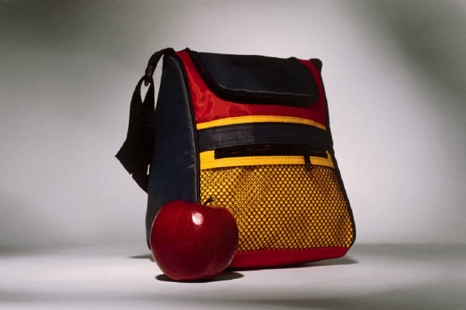
Habit 1 –Be Proactive
You’re in Charge!
“I know that I was wrong when I called my classmate a bad name. I said I was sorry because I know I hurt her feelings.”
Set a Family Work time and area for homework to be completed
I know I am being proactive when ……
I am a responsible person. I choose my actions, attitudes, and moods. I do not blame others for my wrong actions. I do the right thing without being asked, even when no on is looking.
Pack your backpack at night.

Slide 4



Habit 2- Begin With the End in Mind
Have a Plan
Make a goal for yourself. What do you want to get better at ?
What could you do to help the world be a better place?
“My goal is to practice so that I can be the best gymnast. I want to be in the Olympics someday!”
I am beginning with the end in mind…..
I plan ahead and set goals. I do things that have meaning and make a difference. I am an important part of my classroom and contribute to my school’s mission and vision. I look for ways to be a good citizen

Slide 5
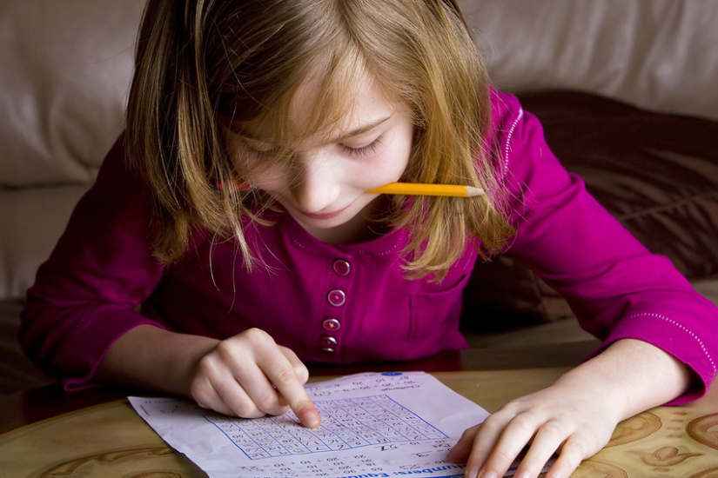
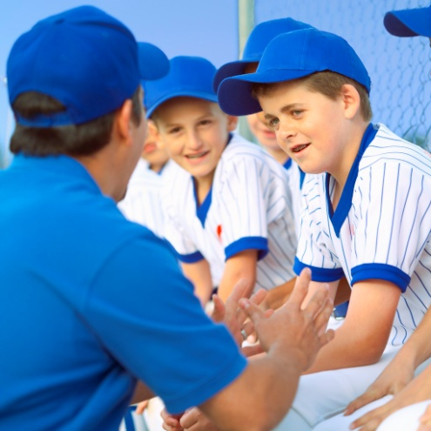
Habit 3 – Put First Things First
Work First, Then Play
When I put First Things First….
I spend my time on things that are most important. This means I say no to things I know I should not do. I set priorities, make a schedule, and follow my plan. I am disciplined and organized.
“My friends want me to come outside and play.. But I know I have to finish my homework FIRST . When I finish it, I know I can go meet them outside”.
My List..
do homework
play outside
eat dinner
read a book
pack my book bag
get ready for bed

Slide 6


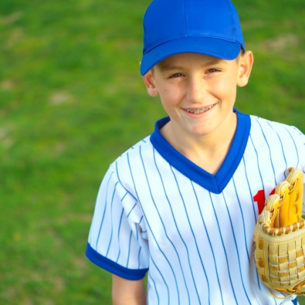
Habit 4 - Think Win- Win
Everyone can Win
Habit 4 —If I IF
I am Thinking Win-Win if……
I balance courage for getting what I want with consideration for what others want. I make deposits in others’ Emotional Bank Accounts. When conflicts arise, I look for third alternatives.
My friend Mike was having a bad day.
He was upset because he didn’t make the baseball team and I did. I asked the coach if he could be our manager and then he could still be part of our team. The coach agreed and Mike was so excited to be on our team. The coach was happy too because Mike was a good scorekeeper.

Slide 7
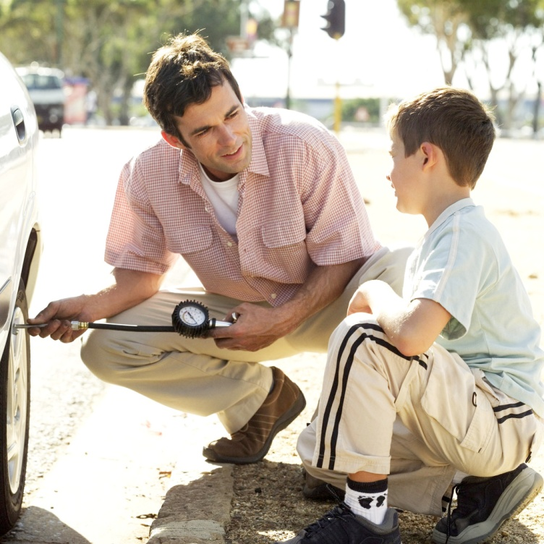
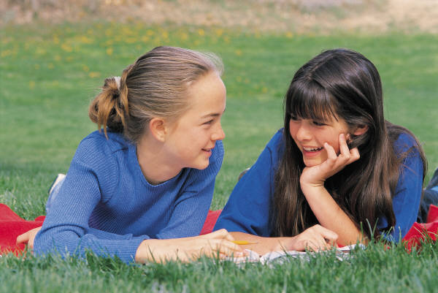

Habit 5-Seek First to Understand, then to Be Understood
Listen Before you Talk
My dad was annoyed because he had a flat tire. I listened to him explain how everything just kept going wrong today.. He apologized for his bad mood. I told him I understood and it was okay. I helped him change the tire and we went out for ice cream. He was laughing and he was glad that I listened to him.
I listen to other people’s ideas and feelings. I try to see things from their viewpoints. I listen to others without interrupting. I am confident in voicing my ideas. I look people in the eyes when talking.

Slide 8


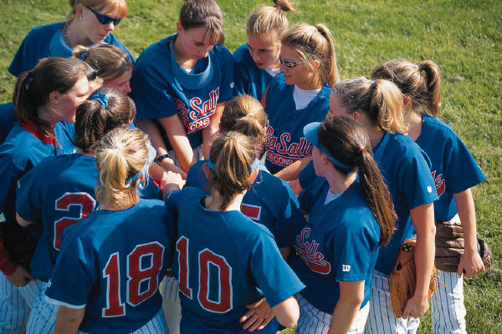
Habit 6-Synergize
Together is Better
I am showing synergy when…
I value other people’s strengths and learn from them. I get along well with others, even people who are different than me. I work well in groups. I seek out other people’s ideas to solve problems because I know that by teaming with others we can create better solutions than anyone of us can alone. I am humble.
I couldn’t figure out how to solve the math word problem. I was embarrassed at first to ask for help.. Luckily our teacher told us to work with partners and help each other. When Lynn explained it to me and how she got the answer.. Then I knew how to do the rest of the problems. She had a great idea!

Slide 9



Habit 7 –Sharpen the Saw
Balance Feel Better
I Sharpen the Saw when I….
I take care of my body by eating right, exercising and getting sleep. I spend time with family and friends. I learn in lots of ways and lots of places, not just at school. I find meaningful ways to help others.
Eating healthy foods
Playing with a ball
Exercising on the beach
Getting plenty of sleep

Slide 10
7 Habits
What are the 7 Habits?
Habit 1: Be Proactive®
I am a responsible person. I take initiative. I choose my actions, attitudes, and moods. I do not blame others for my wrong actions. I do the right thing without being asked, even when no one is looking.
Habit 2: Begin With the End in Mind®
I plan ahead and set goals. I do things that have meaning and make a difference. I am an important part of my classroom and contribute to my school’s mission and vision. I look for ways to be a good citizen.
Habit 3: Put First Things First®
I spend my time on things that are most important. This means I say no to things I know I should not do. I set priorities, make a schedule, and follow my plan. I am disciplined and organized.
Habit 4: Think Win-Win®
I balance courage for getting what I want with consideration for what others want. When conflicts arise, I look for a win-win solution.
Habit 5: Seek First to Understand, Then to Be Understood®
I listen to other people’s ideas and feelings. I try to see things from their viewpoint (paradigm). I listen to others without interrupting. I listen with my ears, my eyes, and my heart. I am confident voicing my ideas.
Habit 6: Synergize®
I value other people’s strengths and learn from them. I get along well with others, even people who are different than me. I work well in groups. I seek out other people’s ideas because I know that by teaming with others, we can create better solutions than any one of us can alone. I look for Third Alternatives.
Habit 7: Sharpen the Saw®
I take care of my body by eating right, exercising, and getting enough sleep (body). I learn in lots of ways and lots of places, not just at school (brain). I spend time with family and friends (heart). I take time to find meaningful ways to help people (soul). I balance all four parts.

Slide 11

Sing along ~ with the 7 Habits song
Watch a YouTube video of Jannah Bolin signing the 7 Habits Song !
http://www.youtube.com/watch?feature=player_detailpage&v=sYDCJR_ApEQ

Slide 12
Thank you!
This power point was created for use in my classroom to help teach The 7 Habits of Happy Kids by Sean Covey .
Thank you for visiting our store – Kennedy’s Korner.
We hope you enjoy using this in your classroom. Your purchase was intended for your classroom only. Please do not share with any colleagues.
If you have any questions you can reach us at coachkennedy22@yahoo.com. ©Kennedy’s Korner 2012

