Slide 1
Habit #5 Seek First to Understand, Then to Be Understood
Based on the work Stephen Covey.

Slide 2
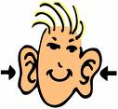
Listening Road Blocks
Spacing Out: Your mind wanders when others talk. | Pretend Listening: You don’t really pay attention to the other person, but you pretend to. You say “yeah,”, “uh-huh,” and “cool.”
Selective Listening: You listen only to the parts that interest you. | Selfish Listening: You always bring the conversation back to you and your life. You say things like “I had that happen too” and “I know how you feel.”

Slide 3
We all have times when we are poor listeners. Which “Listening Road Block” do you most often use? Explain why this happens.
Journal Entry or Discussion Starter:

Slide 4
I’m All Ears
Everybody wants to be listened to. When people feel like you listen, they are more likely to like you. So, be a good listener, and you’ll have lots of friends.
What are some ways that you can show people that you ARE listening?
Who is a good listener? Create a list of people that you know that listen well.

Slide 5
Listen With Your Eyes: Sometimes you have to listen with your eyes as much as you listen with your ears. People say a lot with their body language and facial expressions.

Slide 6
Emotion Charades: Find a partner. Practice ‘listening with your eyes”. Choose an emotion to try to express just with your face and body. You can not use words.
Angry
Sad
Embarrassed
Tired
Happy
Thinking
Bored
Impatient
Scared
Worried
Relaxed
Frustrated
Surprised
Stressed
Confused
Flattered
Nervous
Annoyed
Interested

Slide 7
Mirror, Mirror
To be a good listener, mirror back what someone says. Repeat back in your own words what the person is saying. Use statements like “You seem to be feeling…” and “So what you are saying is…”

Slide 8
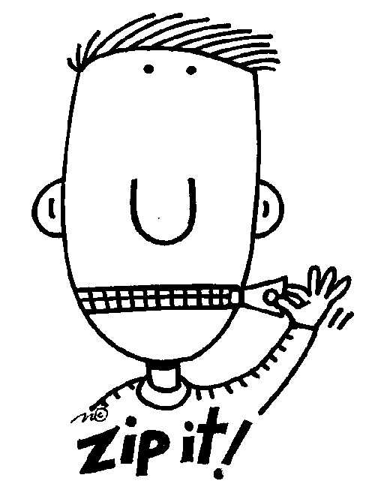
Journal Entry or Discussion Starter:
Have you ever had a time with your family or friends when you knew that you needed to “zip it” and just listen? Why is it important to do this sometimes? How does this help the person you are listening to?

Slide 9
Are you a good listener?
Very
Good Listener
Not Such a Great Listener
How could you be a better listener?

Slide 10
Credits: This slide show was created by Rebecca Radicchi using the following resources.
The Seven Habits for Highly Effective People by Stephen Covey
The Seven Habits for Highly Effective Kids by Sean Covey
The Seven Habits for Highly Effective Teens by Sean Covey

